Slide 1
Capstone 1: Data Exploration on Caravan Insurance

Slide 2
Data
Source:
https://www.kaggle.com/uciml/caravan-insurance-challenge

Slide 3
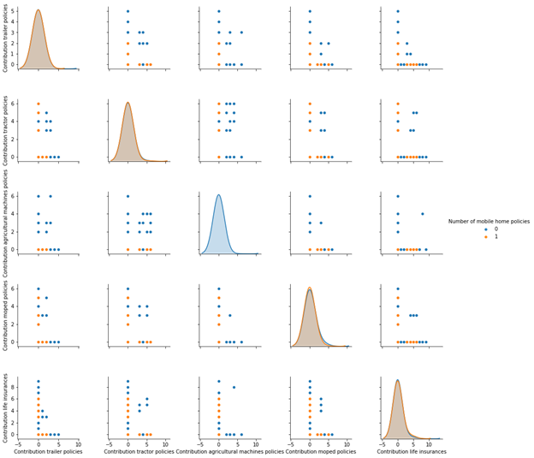
EDA
Pair Plot

Slide 4
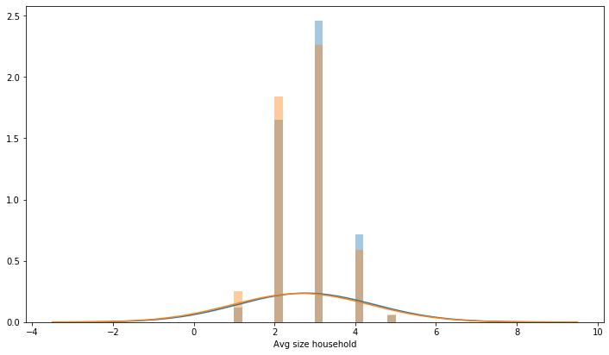
EDA
Histogram

Slide 5
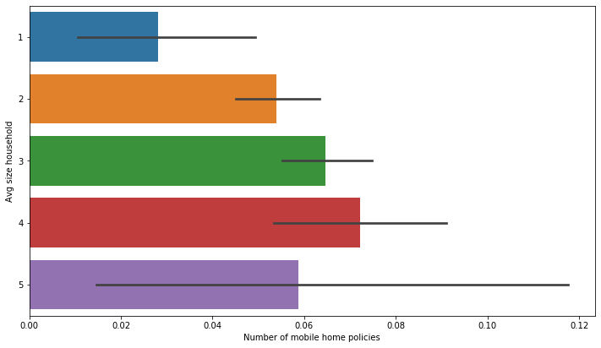
EDA
Bar Plot

Slide 6
Statistical Inference
Chi Square test
Bootstrap

